Slide 1
Head and Shoulders Pattern Recognition and Prediction
STAT GR5293 Final Project
delivered by
Rongbing Liang(rl3081), Chenxi Wang (cw3198) & Yena Lee(yl4315)

Slide 2
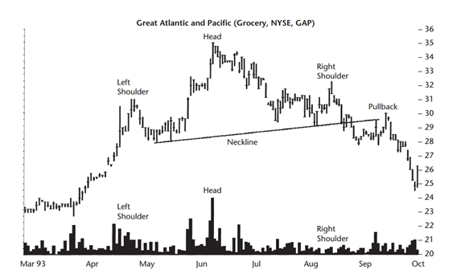
Research Question
Can Head-and-Shoulder (HS) pattern be detected and predicted by algorithm?
Alternative Hypothesis: HS can be quantified, matched, and forecasted.
Objective and Value-add:
Matching: Recognize HS pattern efficiently via online method
Features: Explore features with prediction power
Prediction: Accurately forecast HS pattern before completion

Slide 3
Findings/Results
HS patterns can be successfully recognized and predicted
The most important feature determining whether a half-HS pattern at E3 will develop to a complete HS pattern is:
The difference between th height at E3 at time t and the height at time t+1
The prediction model has small false alarm rate, i.e. it rarely predicts non-HS patterns to be HS patterns. However, it misses a large proportion of HS patterns and predicts them to be non-HS patterns

Slide 4
Data
Raw data: 5-min close price of Heating oil futures (HO), from 2010-01-01 to 2018-01-01
Source: Bloomberg
Data structure: high-frequency time series
Data manipulation:
Missing: omitted
Constructed dataset: raw data is allowed to overlap for get cases

Slide 5
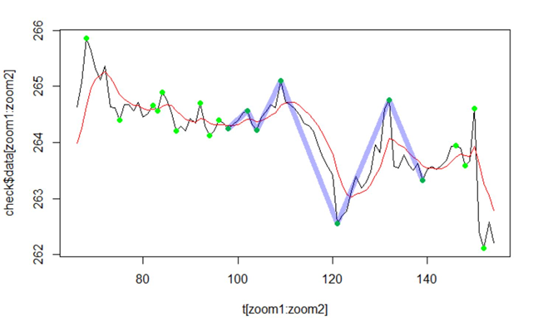
Pattern Matching
Goal: Identify HS patterns in time series data
Step 1: Fit a kernel regression estimator to approximate time series
Step 2: Determine local extrema in the original data by identifying changes of derivatives in the kernel-smoothed data
Step 3: Define head and shoulders pattern in mathematical terms
Step 4: Search for qualified HS patterns
Original data
Kernel-smoothed data
Local extrema
HS pattern

Slide 6
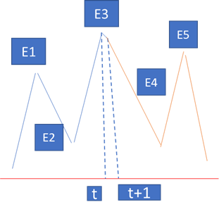
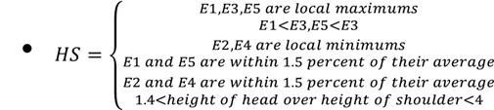
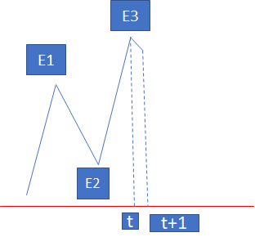
Modeling -- Feature Extraction
Positive case:
All local extrema E(Ei, Ei+1…Ei+5) satisfy the definition of HS pattern
Negative case:
Only the first three local extrema satisfy the definition of HS pattern

Slide 7
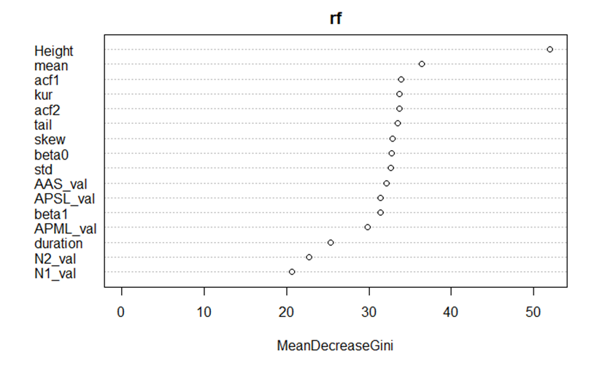
Modeling -- Feature Extraction
Statistic features (6):
Mean: Arithmetical average of price change
Standard deviation of price change
Skewness of price change
Kurtosis of price change
Autocorrelation: the first and second autocorrelation of return
Shape features (16):
Length of the first three segments
Duration of the first three segments
Height difference between E3 (time t) and time t+1
APML: the area between the pattern and the mean line
N1: the number of mean crossing
APSL: the area between the pattern and its least square line
ASS: the area between the least-square line and the line segments
N2: the number of least square line crossing
Intercept for the least square line
Slope for the least square line
Feature importance diagram of the fitted model.
Height difference between E3 (time t) and time t+1 is the most significant feature.

Slide 8
Modeling -- Performance
Modeled using random forest → misclassification rate: 38%
Confusion matrix:
Although the overall model accuracy did not meet our expectation, we achieved low false positive error rate, i.e. small false alarm ratio -- the model rarely classified non-HS patterns as HS patterns.
 | Prediction 0 (Non-HS) | Prediction 1 (HS) | Error Rate
Class 0 (Non-HS) | 507 | 143 | 0.22
Class 1 (HS) | 302 | 124 | 0.71

Slide 9
Future Direction
When trying to improve model performance, we deleted features that are perfectly correlated, but this did not change the misclassification rate at all. Thus, exploration of more informative features is needed. Volume and alternative data may be possible directions
Hyperparameters used in the model such as bandwidth and rolling window length may be further optimized
Target function can be altered to decrease false negative rate
HS pattern during economic contraction period could be a study of interest
Matching method allowing variable time horizons could be introduced to improve the accuracy of HS pattern recognition
Generalize this model to predict other technical patterns

Slide 10
Appendix (Background Research)

Slide 11
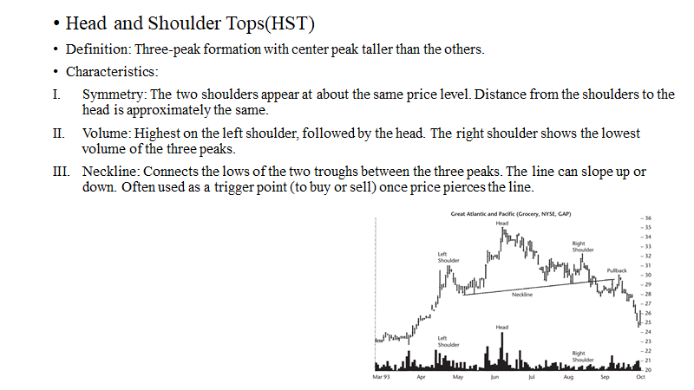

Slide 12
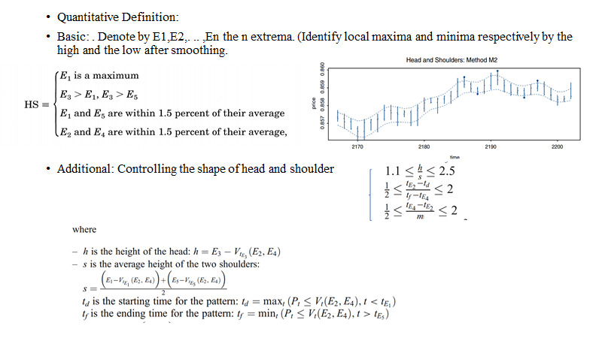

Slide 13
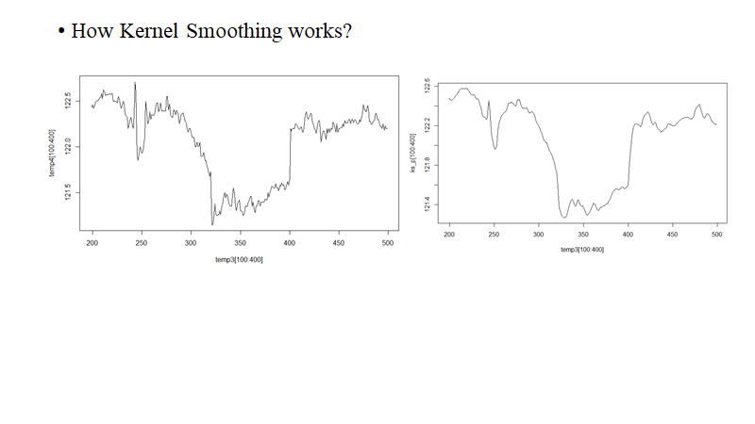

Slide 14
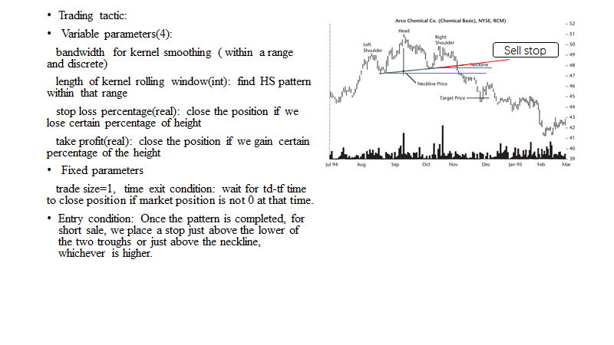

Slide 15
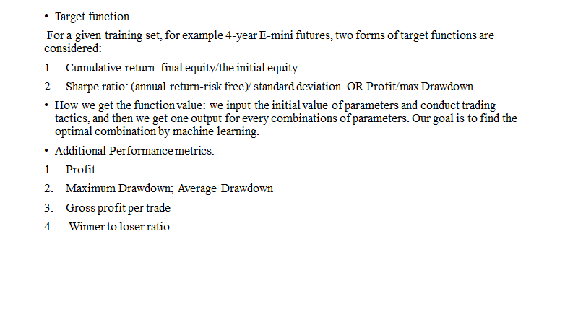

Slide 16


Slide 17


Slide 18
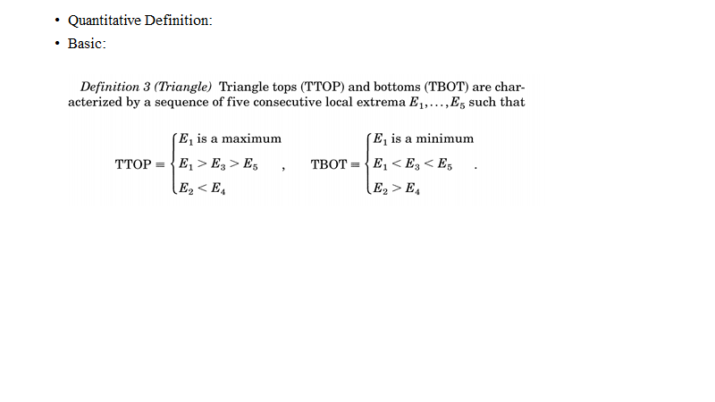

Slide 19
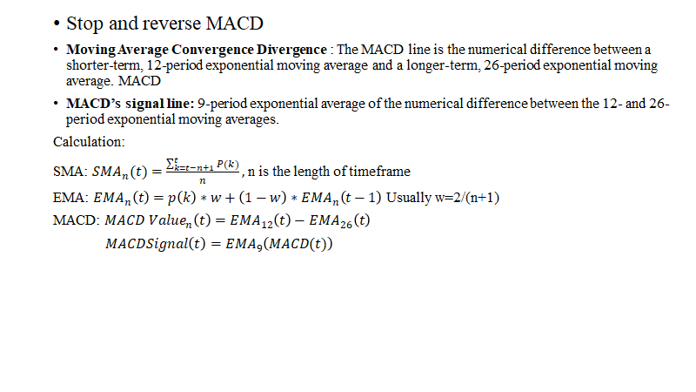

Slide 20
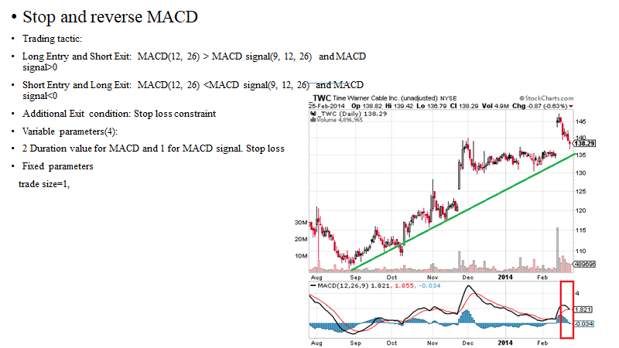

Slide 21
